Slide 1

Devops: The Technology Value Stream
Andrew Stiles
CSD-380
8/23/2025

Slide 2

Introduction
The Technology Value Stream shows how ideas become customer value.
Key focus: shortening the path from development to production.
We’ll explore:
Lead Time vs. Processing Time
Common delays in traditional deployments
DevOps ideal of rapid, reliable delivery

Slide 3

Technology Value Stream
Flow of work: idea → code → production → customer
Ensures value is only realized when code runs in production
Goal: fast, predictable, and reliable delivery
Uses small batches and continuous feedback to reduce risk

Slide 4
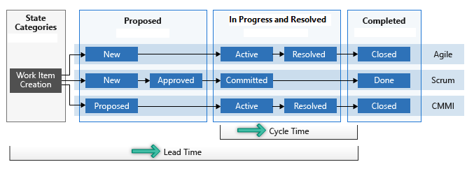
Lead Time Vs. Processing Time
Lead Time: From Request to Delivery (customer view)
Processing Time: Actual hands-on work only
Lead Time includes wait times; Processing Time does not
Improving flow = reduce wait times, not just speed tasks

Slide 5

Long Deployment Lead Times
Common in large, monolithic systems
Causes:
Manual testing and approvals
Complex, tightly coupled code
Limited integration environments
Results:
Releases take months
Frequent failures at late stages
High costs and poor customer outcomes

Slide 6

Devops Ideal: Minutes
Enabled by automation & CI/CD pipelines
Frequent, small code commits lead to fast feedback
Automated testing + modular architecture = reliable releases
Lead times are measured in minutes, not months
Benefits: faster innovation, reduced risk, happier customers

Slide 7

COnclusion
The Technology Value Stream maps work from idea to customer
Lead Time is the key metric that drives customer value
Traditional deployments = months, delays, high risk
DevOps ideal = minutes, automation, continuous feedback
Outcome: Faster, safer, and more valuable software delivery

Slide 8
Sources:
Humanitec. (2023, July 5). Lead time: A key metric in DevOps. Humanitec. https://humanitec.com/blog/lead-time-a-key-metric-in-devops
Kim, G., Humble, J., Debois, P., Willis, J., & Forsgren, N. (2021). The DevOps handbook: How to create world-class agility, reliability, and security in technology organizations (2nd ed.). IT Revolution Press.
Software.com. (2023, June 12). DevOps guide: Lead time. Software.com. https://www.software.com/devops-guides/lead-time

